Slide 1


Department of Computer Science and Engineering
TEXT-BASED EMOTION CLASSIFICATION USING ML with NLP
Dhuneesha.E (211419104066)
Divya.S (211419104072)
Nivedha.U (211419104185)
Guide & co-ordinator
Dr.Kavitha Subramani M.E,Ph.D.,

Slide 2
Abstract
The collection and evaluation of emotions are for the focus of the sentiment analysis’ subfield known as emotion detection. With the ease of obtaining data and the numerous advantages its deliverables provide, many researches are being conducted in the area of text mining and analysis. The proposed approach in text has lately been more well-liked due to its numerous possible applications in marketing, development research, behavioural science, social interaction, automation, etc. In the proposed approach, the text emotion recognition used both speech as well as text to detect emotions. Hence, these methods fall short of creating a useful and flexible system for emotion recognition. A fresh approach was suggested and put into practise for detecting emotions in short entries. As opposed to conventional methods, which are mostly focused on statistical techniques, this approach attempts to infer and extract the causes of emotions by importing information and theories from other disciplines, such as sociology. The approach of emotion cause extraction is employed as a critical step to enhance the quality of chosen characteristics, and it is based on the idea that a prompting cause event is an essential component of emotion.NLP is used to build the supervised machine learning algorithms, and accuracy metrics are used for comparison.The best model, or the one with the highest accuracy, is then chosen after a comparison of the three, and it is implemented into a webpage. The algorithms used are Linear SVM, Random Forest, Decision Tree Classifier. The three models are then compared and the best one ie the one with highest accuracy is deployed into a webpage. The highest accuracy obtained from the above algorithms is 90%. This paper provides a webpage for emotion recognition that takes voice and text input with accurate results.

Slide 3
Literature Survey
Year | Author | Title | Methodology | Merits and Demerits | Future scope
2022 | Lea Canales; Walter Daelemans; Ester Boldrini; Patricio Martínez-Barco | EmoLabel: Semi-Automatic Methodology for Emotion Annotation of Social Media Text Journal: IEEE Transactions on Affective Computing ( Volume: 13, Issue: 2, 01 April-June 2022) Page(s): 579 - 591 Date of Publication: 09 July 2022 | BLSTM-and-self-attention-based SER method using self-attention weight correction (SAWC) with confidence measures | Merits: Accuracy is increased by 20% Demerits: Semi automatic technique is used | Exact accuracy not mentioned.

Slide 4
Literature Survey
Year | Author | Title | Methodology | Merits and Demerits | Future scope
2022 | Namrata Chaudhari; Reshu Agarwal; Meghna Narwade; Xinrui Yu; Jafar Saniie | Artificial Intelligence System for Emotion Recognition and Text Analytics Journal: IEEE Xplore Date: 07 July 2022 | Deep neural network (DNN) for classifying emotions based on features extracted from facial expressions | Merits: accuracy of about 86.75%, The integrated system extracts video and audio simultaneously with a frame rate of 4-5 fps. Demerits: The emotion classified using speech is only three types(positive,negative,neutral) | Types of emotions can be increased.

Slide 5
Literature Survey
Year | Author | Title | Methodology | Merits and Demerits | Future scope
2022 | Samuel Kakuba; Alwin Poulose; Dong Seog Han | Deep Learning-Based Speech Emotion Recognition Using Multi-Level Fusion of Concurrent Features Journal: IEEE Access ( Volume: 10) Page(s): 125538 - 125551 Date of Publication: 30 November 2022 | Multi-level fusion first at the LFLB level, uses a combination of dilated causal convolutions (DCC), Bi LSTM, transformer encoders (TE), multi-head and self-attention mechanisms | Merits: achieves 75.50% and 75.82% of weighted and unweighted accuracy, 75.32% and 75.57% of recall and F1 score respectively. Demerits: F1 score is not upto the mark | Explore concurrent feature learning of spatial, temporal and semantic tendencies in all modalities for emotion recognition

Slide 6
Literature Survey
Year | Author | Title | Methodology | Merits and Demerits | Future scope
2022 | N.Susithra; K.Rajalaksmi; P.Ashwath; B. Ajay; D. Rohit; S. Stewaugh | Speech based Emotion Recognition and Gender Identification using FNN and CNN Models Journal: IEEE Access Date: 15 July 2022 | The work proposed in this paper makes use of machine learning neural networks to recognize the gender and emotion of a speaker | Merits: Gender detection accuracy is high(91.46) Demerits: accuracy for emotion detection is low(86%), Only four emotions are detected | Accuracy can be increased for emotion detection.

Slide 7
Proposed System
The proposed model is to build a machine learning model that is capable of classifying what type of emotion in the text. The emotion text are considered to be widespread and controlling them is very difficult as the world is developing toward digital everyone now has access to internet and they can post whatever they want. So there is a greater chance for the people to get misguided. The machine learning is generally build to tackle these type of complicated task. It takes more amount of time to analyse these type of data manually. The machine learning can be used to classify the text whether what type of emotion it is by using the previous data and make them to understand the pattern and improve the accuracy of the model by adjusting parameters and use that model as the classification model. Different algorithms are compared and the best model can be used for classification purpose. The new feature added here is that it can take voice input and convert it into text , then detect the type of emotion in the text.

Slide 8
Software / Hardware used
Software Requirements:
Operating System : Windows 10 or later
Tool : Anaconda with Jupyter
Notebook
Programming Language : Python
Hardware requirements:
Processor : Intel i3
Hard disk : minimum 10 GB
RAM : minimum 4 GB

Slide 9
Methodology used
ALGORITHMS USED
Random forest
Decision Tree Classifier
Linear Support Vector Machine

Slide 10
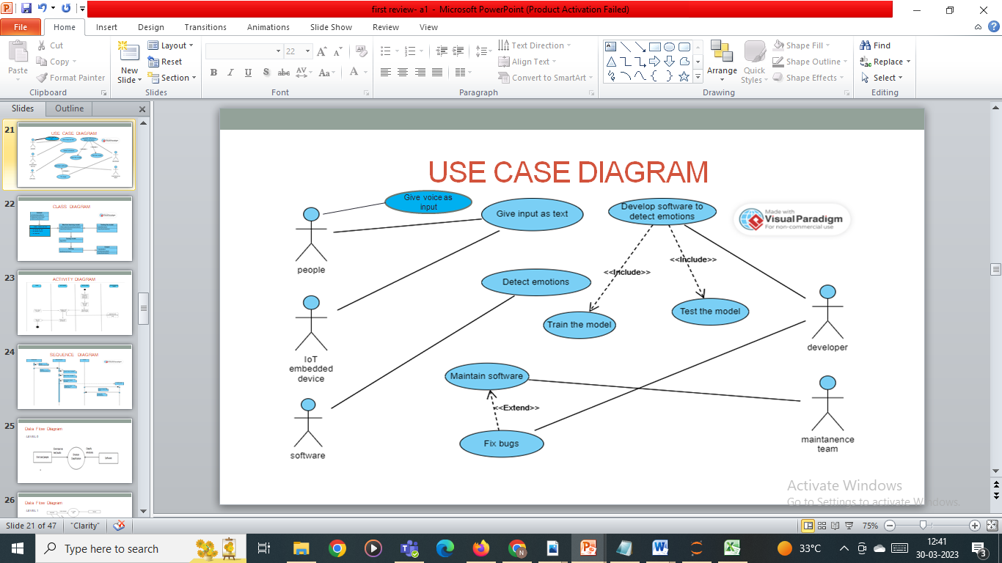
System Design – Use Case Diagram

Slide 11
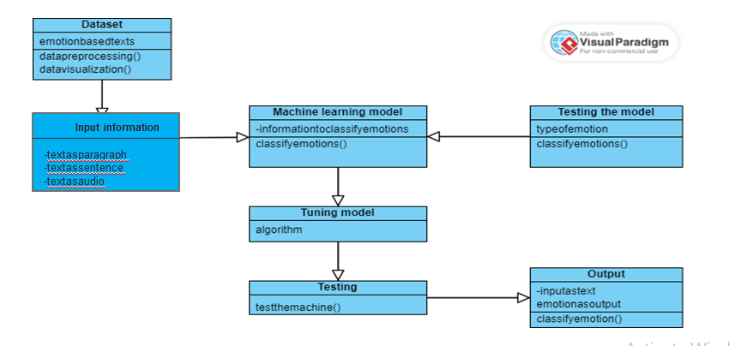
System Design – Class Diagram

Slide 12
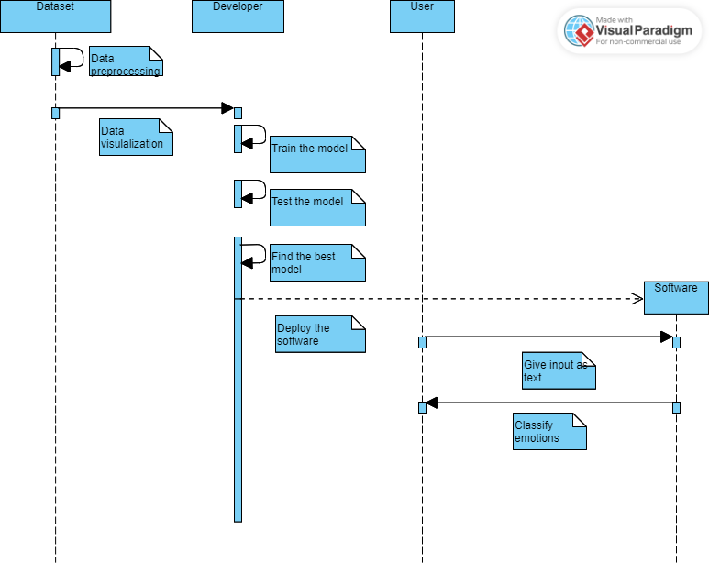
System Design – Sequence diagram
Slide 11 to 13
Flow Chart/DFD/ER Diagram/Use case Diagram/Collaboration /Sequence Diagram

Slide 13
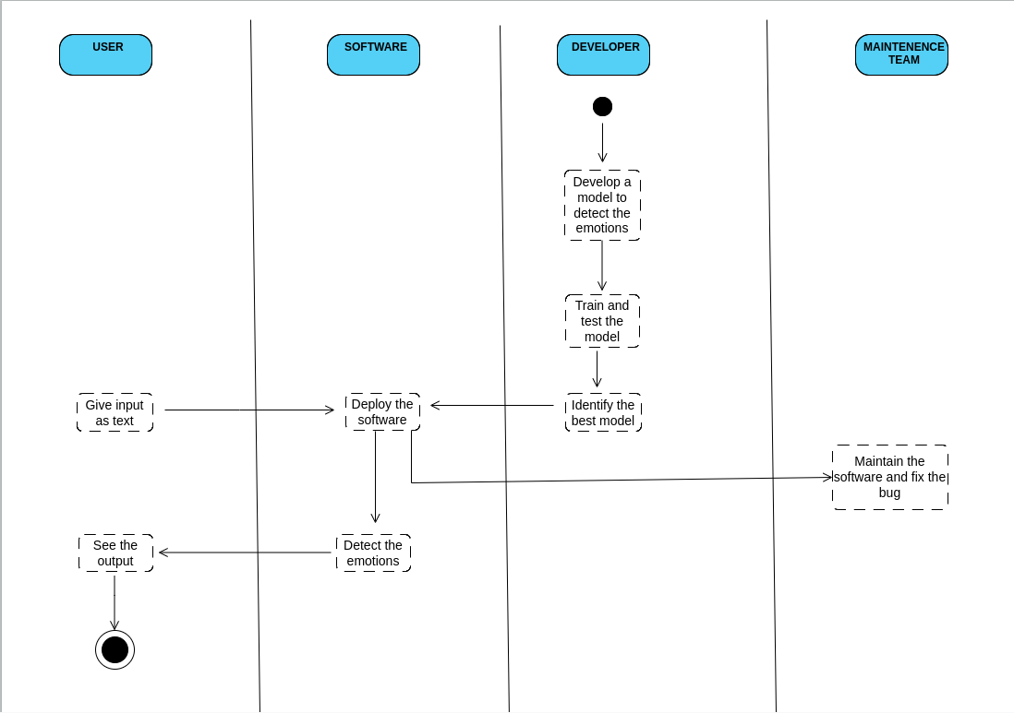
System Design – Activity diagram
Slide 11 to 13
Flow Chart/DFD/ER Diagram/Use case Diagram/Collaboration /Sequence Diagram

Slide 14
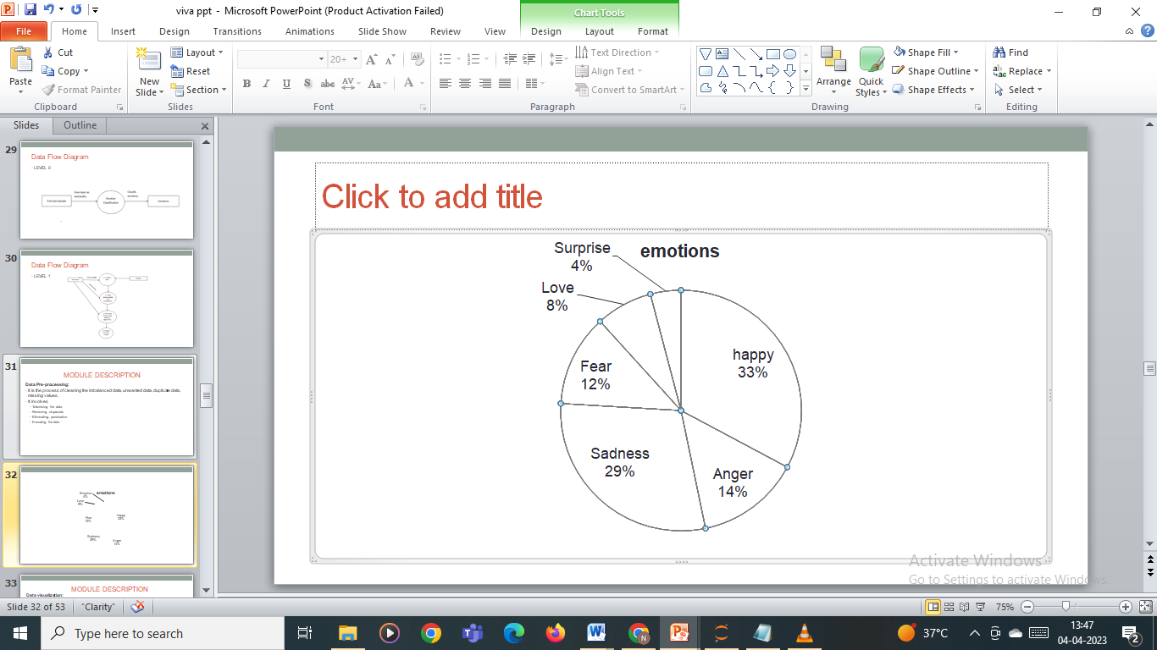
Module Description
Data Pre-processing:
It is the process of cleaning the imbalanced data, unwanted data, duplicate data, missing values.
It involves
Tokenising the data
Removing stopwords
Eliminating punctuation
Encoding the data
Data visualization:
In this project, we use “matplotlib” and “seaborn” library for data visualization. Word clouds are a type of data visualization that can be used to visualize the most commonly used words in a text. Word Clouds were generated for all the emotions in pairwise manner. Overall, data visualization can be a powerful tool for analyzing and understanding patterns in text-based emotion recognition, and can help researchers and practitioners make more informed decisions about how to interpret and use emotional data.

Slide 15
Module Description
1)Decision Tree Classifier
A tree has many analogies in real life, and turns out that it has influenced a wide area of machine learning, covering both classification and regression. In decision analysis, a decision tree can be used to visually and explicitly represent decisions and decision making. As the name goes, it uses a tree-like model of decisions. Though a commonly used tool in data mining for deriving a strategy to reach a particular goal, its also widely used in machine learning, which will be the main focus of this article. The Decision Tree Classifier algorithm is trained used the “DecisionTreeClassifier” module form sklearn.tree library. The hyperparameters used in this algorithm are max_depth, criterion. The max_depth represents the depth of the decision tree and the criterion shows the measure of quality of split. The max_depth value is set to 1000. The criterion used for building decision tree is entropy.

Slide 16
Module Description
2)Random Forest
The following are the basic steps involved in performing the random forest algorithm:
Pick N random records from the dataset.
Build a decision tree based on these N records.
Choose the number of trees you want in your algorithm and repeat steps 1 and 2.
Random Forest is trained used the “RandomForestClassifier” module form sklearn.ensemble library. The dataset is split into train and test ie. “X_train, X_test, y_train, y_test”. The size of test dataset is 20% of the total dataset. The value of random state used to train the model using Random Forest is 42. One of the hyperparameters used in random forest is “n_estimators”. The default value is 10 and it is set to 100 in this model. The n_estimators represents the number of decision trees.

Slide 17
Module Description
3)Linear SVM
A Linear Support Vector Machine (SVM) is a type of machine learning algorithm used for classification and regression analysis. It is a type of supervised learning algorithm that works by finding the hyperplane that best separates the data into different classes.
The Linear Support Vector Machine algorithm is trained used the “LinearSVC” module form sklearn.svm library. The size of test dataset is 20% of the total dataset. The value of random state used to train the model using Linear SVM is 42.

Slide 18
Module Description
Deployment
In this module the trained machine learning model is converted into pickle data format file (.pkl file) which is then deployed in our flask framework for providing better user interface and predicting the output of how much the given data is emotions based on texts. The webpage takes voice as well as text input to recognize emotions. The voice input method is achieved using HTML and Javascript code.

Slide 19
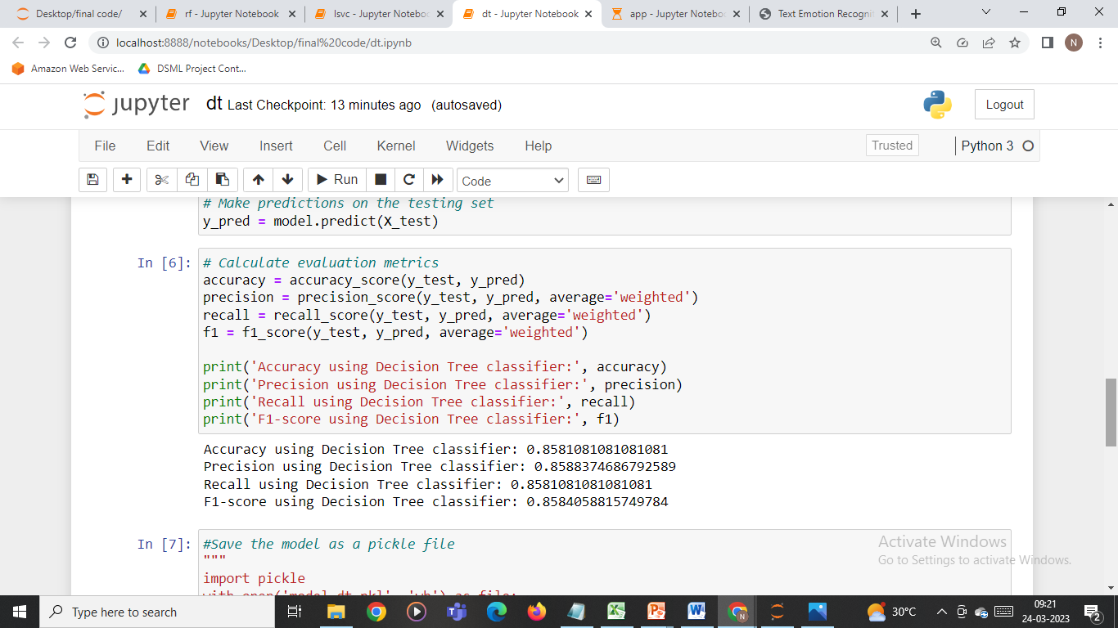
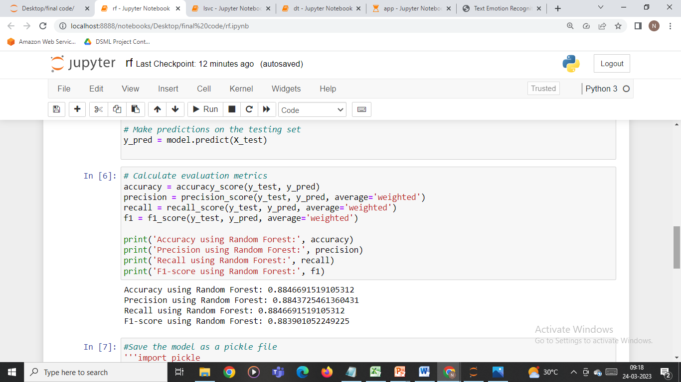
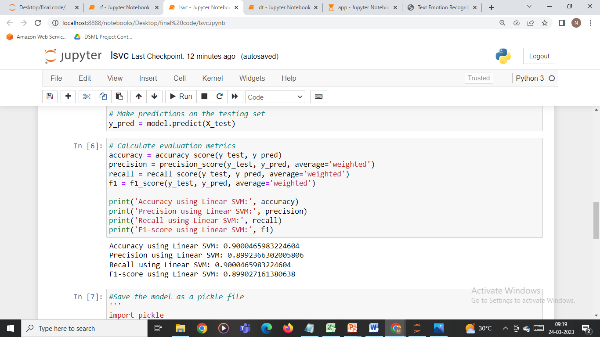
Performance Evaluation

Slide 20
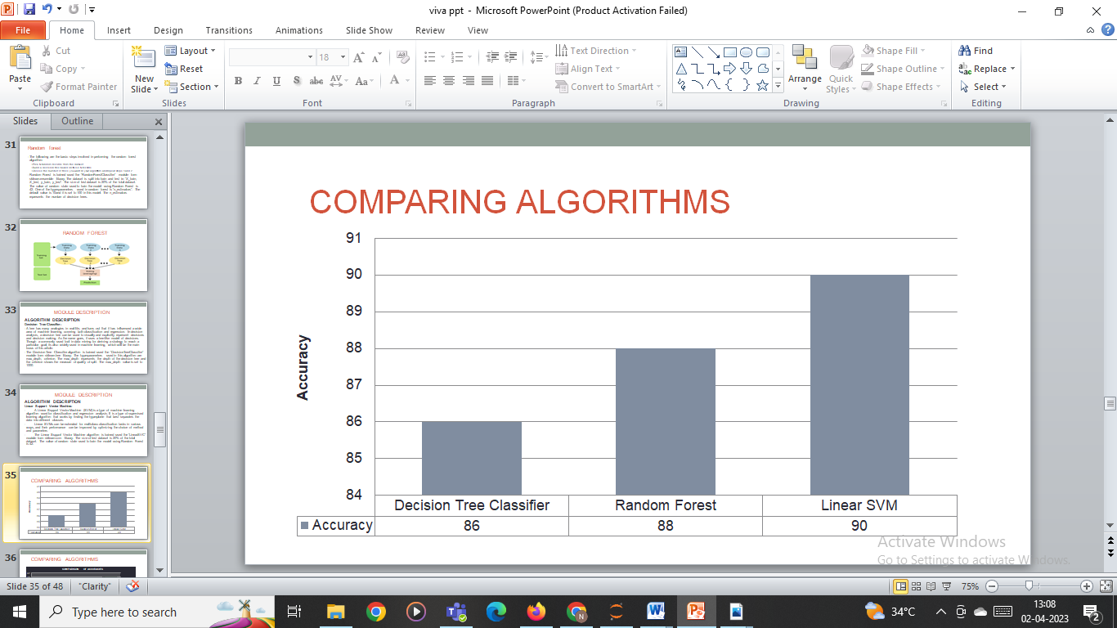
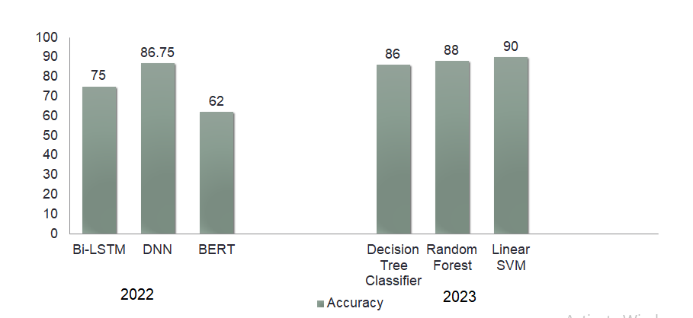
Performance Evaluation

Slide 21
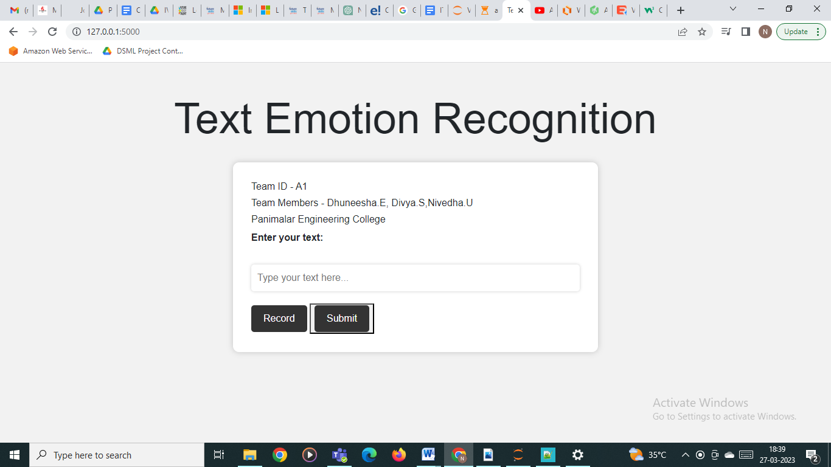
Screen Shots

Slide 22
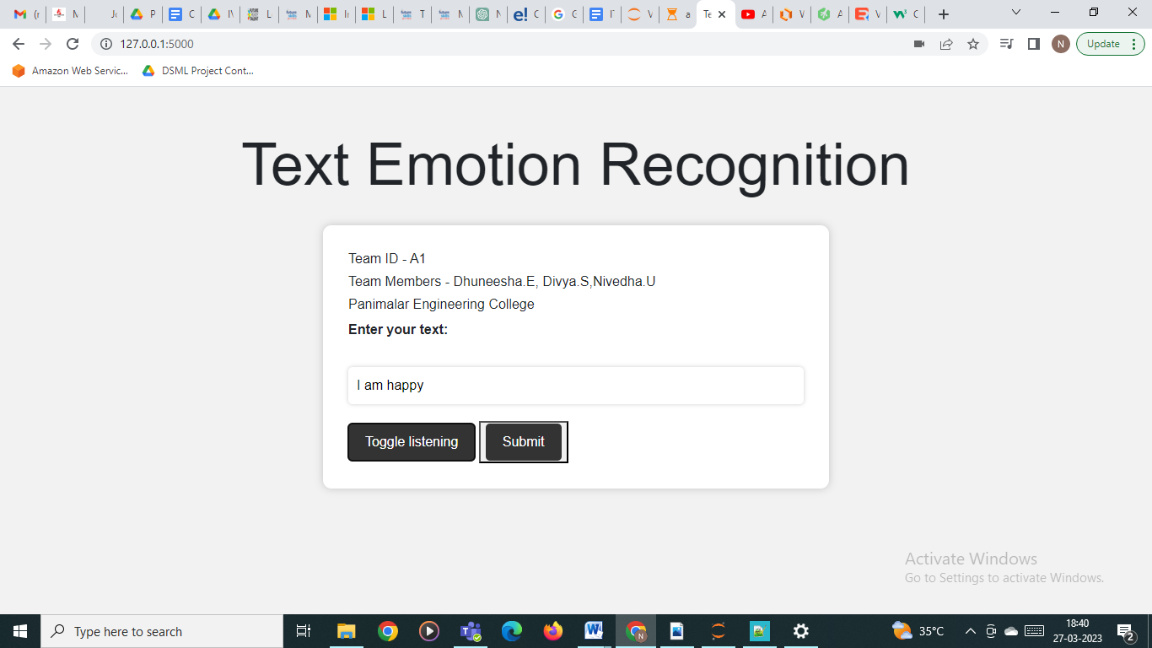
Screen Shots

Slide 23
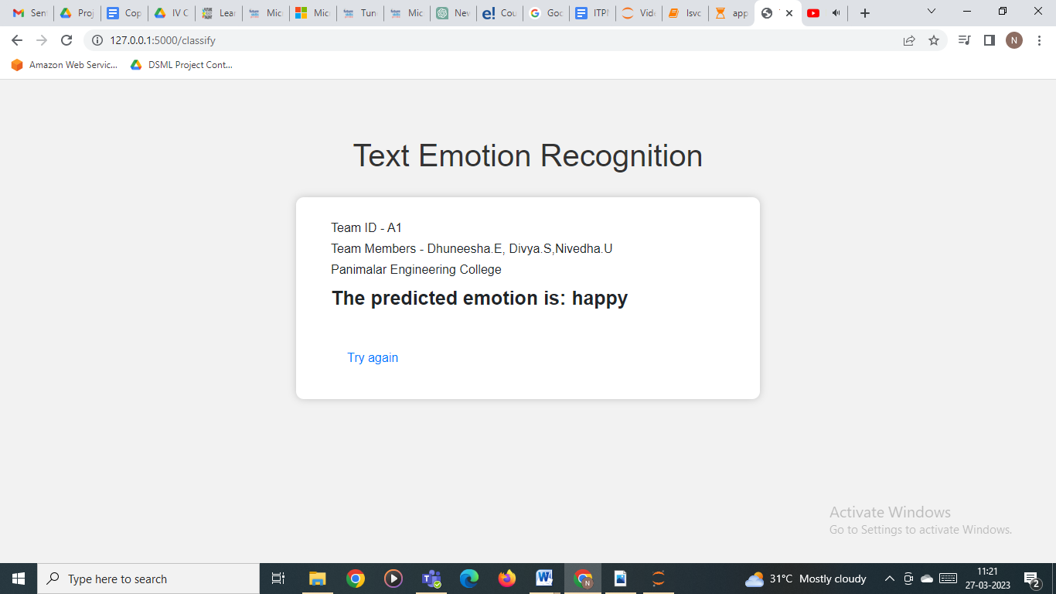
Screen Shots

Slide 24
Conclusion / Feature Enhancement
Various approaches have been proposed to tackle this problem, including rule-based systems, machine learning methods, and deep learning models. The performance of these models largely depends on the quality and size of the training data, feature engineering, and the choice of the classification algorithm. Nevertheless, recent studies have shown promising results, and text-based emotion recognition has practical applications in various domains, including social media monitoring, mental health diagnosis, and customer service. Furthermore, the development of cross-lingual and cross-cultural emotion recognition models can enable these systems to be used in multilingual and multicultural environments. Finally, the ethical implications of using emotion recognition technology must be carefully considered, and privacy concerns and biases in training data must be addressed to ensure that these systems are developed and used responsibly.

Slide 25
Reference Paper/ URL
Lea Canales; Walter Daelemans; Ester Boldrini; Patricio Martínez-Barco
, “EmoLabel: Semi-Automatic Methodology for Emotion Annotation of Social Media Text” in IEEE Transactions on Affective Computing ( Volume: 13, Issue: 2, 01 April-June 2022)
N.Susithra, K.Rajalaksmi, P.Ashwath, B.Ajay, D. Rohit, S. Stewaugh, “Speech based Emotion Recognition and Gender Identification using FNN and CNN Models” in IEEE Access, July 2022
Meenu S Nair; Deepa P Gopinath, “Transfer learning for Speech Based Emotion Recognition” in 2022 IEEE Access, May 2022
Abhishek Kumar; Amit Kumar Goel, “Speech Emotion Recognition by using Feature Selection and Extraction”, in IEEE Access, June 2022
Namrata Chaudhari; Reshu Agarwal; Meghna Narwade; Xinrui Yu; Jafar Saniie, “Artificial Intelligence System for Emotion Recognition and Text Analytics” in IEEE Xplore, July 2022
Samuel Kakuba; Alwin Poulose; Dong Seog Han, “Deep Learning-Based Speech Emotion Recognition Using Multi-Level Fusion of Concurrent Features” in : IEEE Access ( Volume: 10), November 2022

